Slide 1
W4111 – Introduction to Databases Section 002, Spring 2022 Lecture 5: ER, Relational, SQL (IV)
© Donald F. Ferguson, 2022

Slide 2

Contents
2 | Introduction to Databases (S22): Lecture 6: ER, Relational, SQL (V) © Donald F. Ferguson, 2022

Slide 3
Contents
OHs and HW schedule.
Comments and insights related to homework 2-B and HW3 (coming):
Web application SW architecture.
SQL vs Pandas, Cursors
Codd’s Rules.
Integrity constraints.
Indexes.
Functions, procedures and triggers.
Some advanced ER concepts.
Worked example.

Slide 4
OHs Videos, HW and Exams
4 | Introduction to Databases (S22): Lecture 6: ER, Relational, SQL (V) © Donald F. Ferguson, 2022

Slide 5

Last Night’s Recitation
I was lurking during last night’s recitation.
The recording rendering finished early this AM.
Ferguson started rubbing his hands and laughing diabolically.
Enough is enough.
I hit Ferguson with a batarang.
He was already logged into CourseWorks.
So, I uploaded the video to the OH folder.
You’re welcome.
Sincerely, Batman

Slide 6
Comments and Insights
6 | Introduction to Databases (S22): Lecture 6: ER, Relational, SQL (V) © Donald F. Ferguson, 2022

Slide 7
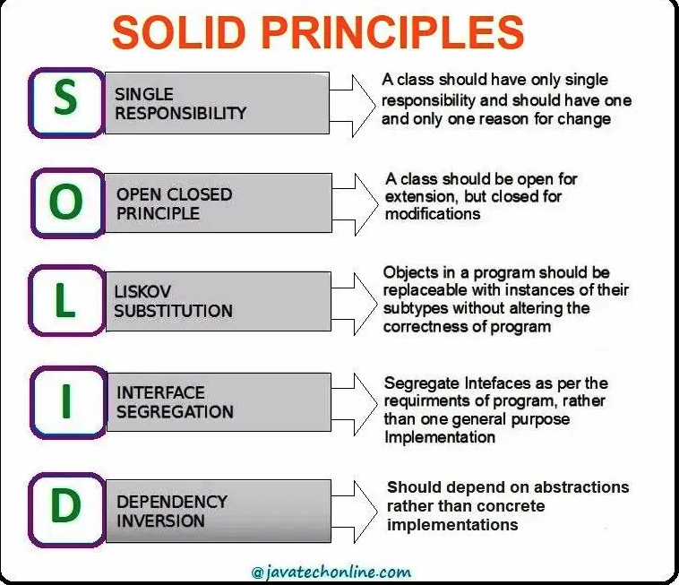
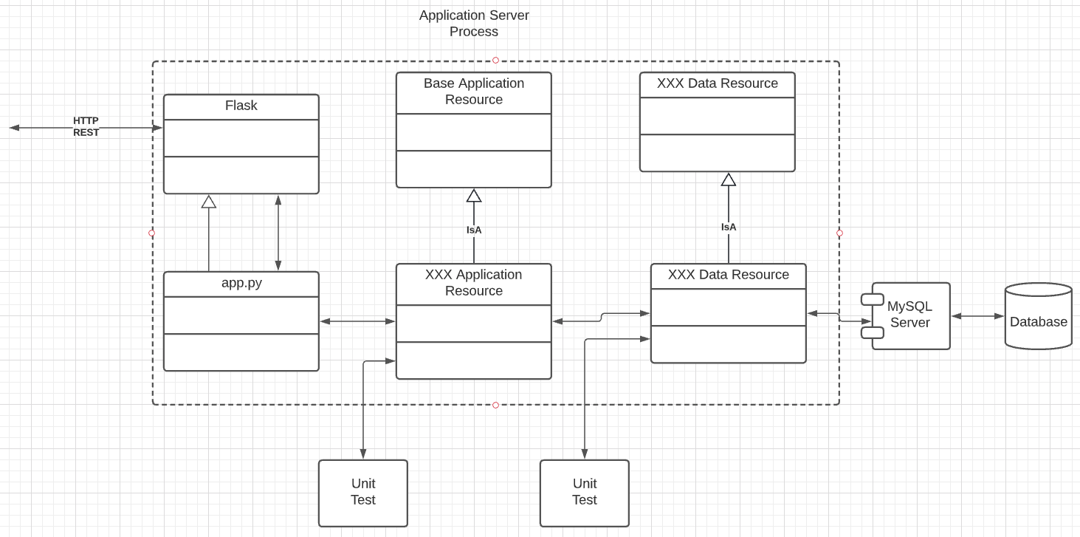
Web Application Architecture
The sample application that I provided is vastly over-simplified to reduce complexity.
Well-designed applications and Web application architecture is a complex space with patterns and anti-patterns.
Some examples:
SOLID Principles apply broadly to components, microservices, etc.
Application design patterns and anti-patterns, e.g. Transfer Object, Factory, Data Access Object, ... ...

Slide 8
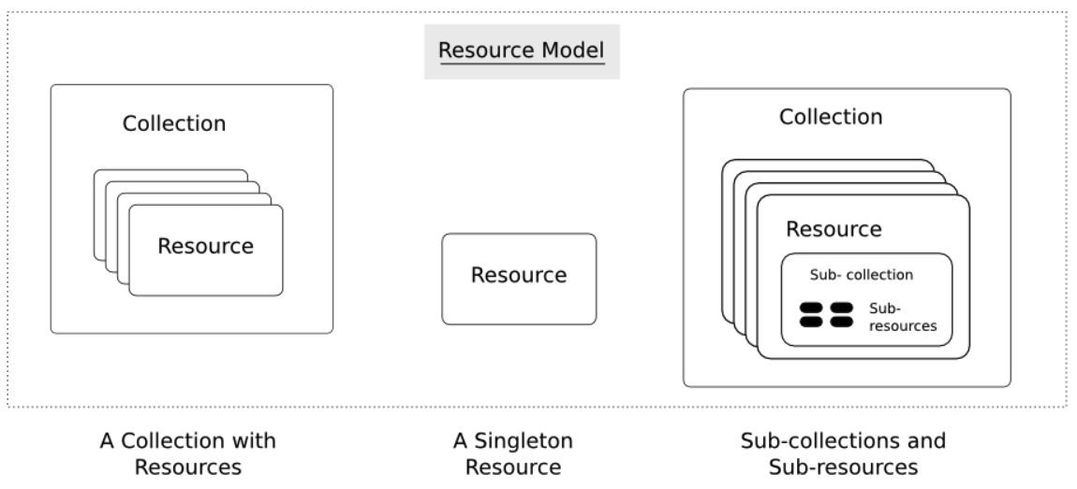
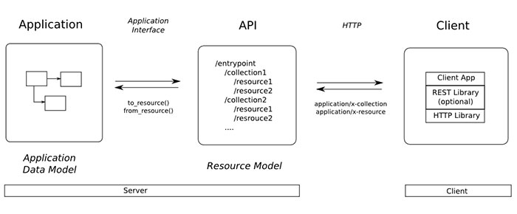
REST
URL/URL
URI = scheme ":" ["//" authority] path ["?" query] ["#" fragment]
authority = [userinfo "@"] host [":" port] (NOTE: Very seldom used)
Paths and queries:
/customers/10100 references the specific customer with primary key value 10100. The pattern is /<resource_name>/primary_key_value
/customers?x=10&y=7& ... ... &Q=12 references matching resources in the customer collection. Logically analogous to select * from customers where x=10 and y=7 and ... ... Q=12

Slide 9
SQL vs Pandas, Cursors
Switch to notebook.

Slide 10
Codd’s Rules Metadata, Integrity
10 | Introduction to Databases (S22): Lecture 6: ER, Relational, SQL (V) © Donald F. Ferguson, 2022

Slide 11
Codd’s 12 Rules
Rule 1: Information Rule
The data stored in a database, may it be user data or metadata, must be a value of some table cell. Everything in a database must be stored in a table format.
Rule 2: Guaranteed Access Rule
Every single data element (value) is guaranteed to be accessible logically with a combination of table-name, primary-key (row value), and attribute-name (column value). No other means, such as pointers, can be used to access data.
Rule 3: Systematic Treatment of NULL Values
The NULL values in a database must be given a systematic and uniform treatment. This is a very important rule because a NULL can be interpreted as one the following − data is missing, data is not known, or data is not applicable.
Rule 4: Active Online Catalog
The structure description of the entire database must be stored in an online catalog, known as data dictionary, which can be accessed by authorized users. Users can use the same query language to access the catalog which they use to access the database itself.
Rule 5: Comprehensive Data Sub-Language Rule
A database can only be accessed using a language having linear syntax that supports data definition, data manipulation, and transaction management operations. This language can be used directly or by means of some application. If the database allows access to data without any help of this language, then it is considered as a violation.
Rule 6: View Updating Rule
All the views of a database, which can theoretically be updated, must also be updatable by the system.

Slide 12
Codd’s 12 Rules
Rule 7: High-Level Insert, Update, and Delete Rule
A database must support high-level insertion, updation, and deletion. This must not be limited to a single row, that is, it must also support union, intersection and minus operations to yield sets of data records.
Rule 8: Physical Data Independence
The data stored in a database must be independent of the applications that access the database. Any change in the physical structure of a database must not have any impact on how the data is being accessed by external applications.
Rule 9: Logical Data Independence
The logical data in a database must be independent of its user’s view (application). Any change in logical data must not affect the applications using it. For example, if two tables are merged or one is split into two different tables, there should be no impact or change on the user application. This is one of the most difficult rule to apply.
Rule 10: Integrity Independence
A database must be independent of the application that uses it. All its integrity constraints can be independently modified without the need of any change in the application. This rule makes a database independent of the front-end application and its interface.
Rule 11: Distribution Independence
The end-user must not be able to see that the data is distributed over various locations. Users should always get the impression that the data is located at one site only. This rule has been regarded as the foundation of distributed database systems.
Rule 12: Non-Subversion Rule
If a system has an interface that provides access to low-level records, then the interface must not be able to subvert the system and bypass security and integrity constraints.

Slide 13
Applications, View Updates
Applications:
This is pretty straight forward.
You see many examples on a daily basis:
CourseWorks, SSOL, IMDB, ... ...
You are getting some insights into building one type.
Almost all AI/ML and data science projects use databases through apps.
View updates:
I normally avoid updating through views, but that is just me.
A view is a SQL expression that maps one or more tables into a single table.
You can perform INSERT, UPDATE, DELETE if it is possible to “reverse the mapping.”
Several things can make this impossible. Aggregation is the obvious example.

Slide 14
Integrity Constraints
14 | Introduction to Databases (S22): Lecture 6: ER, Relational, SQL (V) © Donald F. Ferguson, 2022

Slide 15
Integrity Constraints
Integrity constraints guard against accidental damage to the database, by ensuring that authorized changes to the database do not result in a loss of data consistency.
A checking account must have a balance greater than $10,000.00
A salary of a bank employee must be at least $4.00 an hour
A customer must have a (non-null) phone number

Slide 16
Constraints on a Single Relation
not null
primary key
unique
check (P), where P is a predicate

Slide 17
Not Null Constraints
not null
Declare name and budget to be not null
name varchar(20) not null budget numeric(12,2) not null

Slide 18
Unique Constraints
unique ( A₁, A₂, …, A_{m})
The unique specification states that the attributes A₁, A₂, …, A_{m} form a candidate key.
Candidate keys are permitted to be null (in contrast to primary keys).

Slide 19
The check clause
The check (P) clause specifies a predicate P that must be satisfied by every tuple in a relation.
Example: ensure that semester is one of fall, winter, spring or summer
create table section
(course_id varchar (8),
sec_id varchar (8),
semester varchar (6),
year numeric (4,0),
building varchar (15),
room_number varchar (7),
time slot id varchar (4),
primary key (course_id, sec_id, semester, year),
check (semester in ('Fall', 'Winter', 'Spring', 'Summer')))

Slide 20
Referential Integrity
Ensures that a value that appears in one relation for a given set of attributes also appears for a certain set of attributes in another relation.
Example: If “Biology” is a department name appearing in one of the tuples in the instructor relation, then there exists a tuple in the department relation for “Biology”.
Let A be a set of attributes. Let R and S be two relations that contain attributes A and where A is the primary key of S. A is said to be a foreign key of R if for any values of A appearing in R these values also appear in S.

Slide 21
Referential Integrity (Cont.)
Foreign keys can be specified as part of the SQL create table statement
foreign key (dept_name) references department
By default, a foreign key references the primary-key attributes of the referenced table.
SQL allows a list of attributes of the referenced relation to be specified explicitly.
foreign key (dept_name) references department (dept_name)

Slide 22
Cascading Actions in Referential Integrity
When a referential-integrity constraint is violated, the normal procedure is to reject the action that caused the violation.
An alternative, in case of delete or update is to cascade
create table course ( (… dept_name varchar(20), foreign key (dept_name) references department on delete cascade on update cascade, . . .)
Instead of cascade we can use :
set null,
set default

Slide 23
Integrity Constraint Violation During Transactions
Consider:
create table person ( ID char(10), name char(40), mother char(10), father char(10), primary key ID, foreign key father references person, foreign key mother references person)
How to insert a tuple without causing constraint violation?
Insert father and mother of a person before inserting person
OR, set father and mother to null initially, update after inserting all persons (not possible if father and mother attributes declared to be not null)
OR defer constraint checking

Slide 24
Complex Check Conditions
The predicate in the check clause can be an arbitrary predicate that can include a subquery.
check (time_slot_id in (select time_slot_id from time_slot))
The check condition states that the time_slot_id in each tuple in the section relation is actually the identifier of a time slot in the time_slot relation.
The condition has to be checked not only when a tuple is inserted or modified in section , but also when the relation time_slot changes

Slide 25
Assertions
An assertion is a predicate expressing a condition that we wish the database always to satisfy.
The following constraints, can be expressed using assertions:
For each tuple in the student relation, the value of the attribute tot_cred must equal the sum of credits of courses that the student has completed successfully.
An instructor cannot teach in two different classrooms in a semester in the same time slot
An assertion in SQL takes the form:
create assertion <assertion-name> check (<predicate>);

Slide 26
Built-in Data Types in SQL
date: Dates, containing a (4 digit) year, month and date
Example: date '2005-7-27'
time: Time of day, in hours, minutes and seconds.
Example: time '09:00:30' time '09:00:30.75'
timestamp: date plus time of day
Example: timestamp '2005-7-27 09:00:30.75'
interval: period of time
Example: interval '1' day
Subtracting a date/time/timestamp value from another gives an interval value
Interval values can be added to date/time/timestamp values

Slide 27
Large-Object Types
Large objects (photos, videos, CAD files, etc.) are stored as a large object:
blob: binary large object -- object is a large collection of uninterpreted binary data (whose interpretation is left to an application outside of the database system)
clob: character large object -- object is a large collection of character data
When a query returns a large object, a pointer is returned rather than the large object itself.

Slide 28
User-Defined Types
create type construct in SQL creates user-defined type
create type Dollars as numeric (12,2) final
Example:
create table department (dept_name varchar (20), building varchar (15), budget Dollars);

Slide 29
Domains
create domain construct in SQL-92 creates user-defined domain types
create domain person_name char(20) not null
Types and domains are similar. Domains can have constraints, such as not null, specified on them.
Example:
create domain degree_level varchar(10) constraint degree_level_test check (value in ('Bachelors', 'Masters', 'Doctorate'));

Slide 30
Indexes
30 | Introduction to Databases (S22): Lecture 6: ER, Relational, SQL (V) © Donald F. Ferguson, 2022

Slide 31
Index Creation
Many queries reference only a small proportion of the records in a table.
It is inefficient for the system to read every record to find a record with particular value
An index on an attribute of a relation is a data structure that allows the database system to find those tuples in the relation that have a specified value for that attribute efficiently, without scanning through all the tuples of the relation.
We create an index with the create index command
create index <name> on <relation-name> (attribute);

Slide 32
Index Creation Example
create table student (ID varchar (5), name varchar (20) not null, dept_name varchar (20), tot_cred numeric (3,0) default 0, primary key (ID))
create index studentID_index on student(ID)
The query:
select * from student where ID = '12345'
can be executed by using the index to find the required record, without looking at all records of student

Slide 33
Let’s Practice
Primary
Unique
Unique and Not Null
Index

Slide 34
Functions, Procedures, Triggers
34 | Introduction to Databases (S22): Lecture 6: ER, Relational, SQL (V) © Donald F. Ferguson, 2022

Slide 35

Concepts
35 | Introduction to Databases (S22): Lecture 6: ER, Relational, SQL (V) © Donald F. Ferguson, 2022

Slide 36
Functions and Procedures
Functions and procedures allow “business logic” to be stored in the database and executed from SQL statements.
These can be defined either by the procedural component of SQL or by an external programming language such as Java, C, or C++.
The syntax we present here is defined by the SQL standard.
Most databases implement nonstandard versions of this syntax.
Note:
The programming language, runtime and tools for functions, procedures and triggers are not easy to use.
My view is that calling external functions is an anti-pattern (bad idea).
External code degrades the reliability, security and performance of the database.
Databases are often mission critical and the heart of environments.

Slide 37
Language Constructs for Procedures & Functions
SQL supports constructs that gives it almost all the power of a general-purpose programming language.
Warning: most database systems implement their own variant of the standard syntax below.
Compound statement: begin … end,
May contain multiple SQL statements between begin and end.
Local variables can be declared within a compound statements
While and repeat statements:
while boolean expression do
sequence of statements ;
end while
repeat
sequence of statements ;
until boolean expression
end repeat

Slide 38
(Core) Language Constructs (Cont.)
For loop
Permits iteration over all results of a query
Example: Find the budget of all departments declare n integer default 0; for r as select budget from department where dept_name = 'Music' do set n = n + r.budget end for
Note:
There are various other looping constructs.

Slide 39
(Core) Language Constructs – if-then-else
Conditional statements (if-then-else)
if boolean expression then statement or compound statement elseif boolean expression then statement or compound statement else statement or compound statement end if
Note:
We will not spend a lot of time writing functions, procedures, or triggers.
The language and development environment are not easy to use.

Slide 40
Functions
40 | Introduction to Databases (S22): Lecture 6: ER, Relational, SQL (V) © Donald F. Ferguson, 2022

Slide 41
Declaring SQL Functions
Define a function that, given the name of a department, returns the count of the number of instructors in that department.
create function dept_count (dept_name varchar(20)) returns integer begin declare d_count integer; select count (* ) into d_count from instructor where instructor.dept_name = dept_name return d_count; end
The function dept_count can be used to find the department names and budget of all departments with more that 12 instructors.
select dept_name, budget from department where dept_count (dept_name ) > 12

Slide 42
Table Functions
The SQL standard supports functions that can return tables as results; such functions are called table functions
Example: Return all instructors in a given department
create function instructor_of (dept_name char(20))
returns table (
ID varchar(5), name varchar(20), dept_name varchar(20), salary numeric(8,2))
return table (select ID, name, dept_name, salary from instructor where instructor.dept_name = instructor_of.dept_name)
Usage
select * from table (instructor_of ('Music'))

Slide 43
Procedures
43 | Introduction to Databases (S22): Lecture 6: ER, Relational, SQL (V) © Donald F. Ferguson, 2022

Slide 44
SQL Procedures
The dept_count function could instead be written as procedure:
create procedure dept_count_proc (in dept_name varchar(20), out d_count integer) begin
select count(*) into d_count from instructor where instructor.dept_name = dept_count_proc.dept_name
end
The keywords in and out are parameters that are expected to have values assigned to them and parameters whose values are set in the procedure in order to return results.
Procedures can be invoked either from an SQL procedure or from embedded SQL, using the call statement.
declare d_count integer; call dept_count_proc( 'Physics', d_count);

Slide 45
SQL Procedures (Cont.)
Procedures and functions can be invoked also from dynamic SQL
SQL allows more than one procedure of the so long as the number of arguments of the procedures with the same name is different.
The name, along with the number of arguments, is used to identify the procedure.

Slide 46
Triggers
46 | Introduction to Databases (S22): Lecture 6: ER, Relational, SQL (V) © Donald F. Ferguson, 2022

Slide 47
Triggers
A trigger is a statement that is executed automatically by the system as a side effect of a modification to the database.
To design a trigger mechanism, we must:
Specify the conditions under which the trigger is to be executed.
Specify the actions to be taken when the trigger executes.
Triggers introduced to SQL standard in SQL:1999, but supported even earlier using non-standard syntax by most databases.
Syntax illustrated here may not work exactly on your database system; check the system manuals

Slide 48
Triggering Events and Actions in SQL
Triggering event can be insert, delete or update
Triggers on update can be restricted to specific attributes
For example, after update of takes on grade
Values of attributes before and after an update can be referenced
referencing old row as : for deletes and updates
referencing new row as : for inserts and updates
Triggers can be activated before an event, which can serve as extra constraints. For example, convert blank grades to null.
create trigger setnull_trigger before update of takes referencing new row as nrow for each row when (nrow.grade = ' ') begin atomic set nrow.grade = null; end;

Slide 49
Trigger to Maintain credits_earned value
create trigger credits_earned after update of takes on (grade) referencing new row as nrow referencing old row as orow for each row when nrow.grade <> 'F' and nrow.grade is not null and (orow.grade = 'F' or orow.grade is null) begin atomic update student set tot_cred= tot_cred + (select credits from course where course.course_id= nrow.course_id) where student.id = nrow.id; end;

Slide 50
Statement Level Triggers
Instead of executing a separate action for each affected row, a single action can be executed for all rows affected by a transaction
Use for each statement instead of for each row
Use referencing old table or referencing new table to refer to temporary tables (called transition tables) containing the affected rows
Can be more efficient when dealing with SQL statements that update a large number of rows

Slide 51
When Not To Use Triggers
Triggers were used earlier for tasks such as
Maintaining summary data (e.g., total salary of each department)
Replicating databases by recording changes to special relations (called change or delta relations) and having a separate process that applies the changes over to a replica
There are better ways of doing these now:
Databases today provide built in materialized view facilities to maintain summary data
Databases provide built-in support for replication
Encapsulation facilities can be used instead of triggers in many cases
Define methods to update fields
Carry out actions as part of the update methods instead of through a trigger

Slide 52
When Not To Use Triggers (Cont.)
Risk of unintended execution of triggers, for example, when
Loading data from a backup copy
Replicating updates at a remote site
Trigger execution can be disabled before such actions.
Other risks with triggers:
Error leading to failure of critical transactions that set off the trigger
Cascading execution

Slide 53
Summary
53 | Introduction to Databases (S22): Lecture 6: ER, Relational, SQL (V) © Donald F. Ferguson, 2022

Slide 54
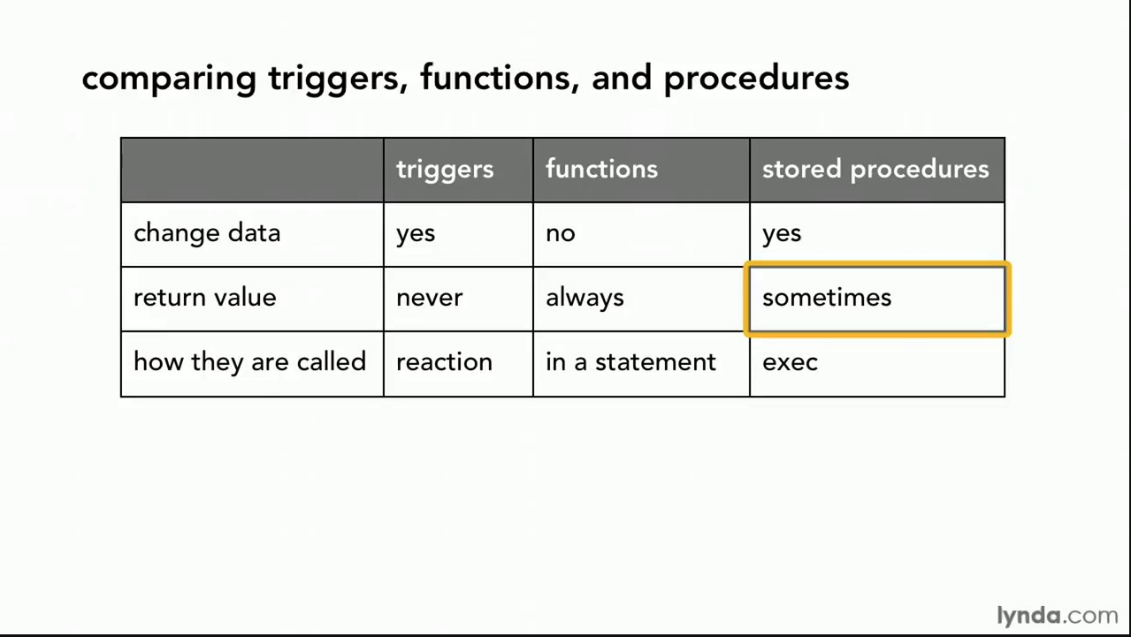
Comparison

Slide 55
Comparison – Some Details
A trigger has capabilities like a procedure, except ...
You do not call it. The DB engine calls it before or after an INSERT, UPDATE, DELETE.
The inputs are the list of incoming new, modified rows.
The outputs are the modified versions of the new or modified rows.

Slide 56
Security
56 | Introduction to Databases (S22): Lecture 6: ER, Relational, SQL (V) © Donald F. Ferguson, 2022

Slide 57
Security Concepts (Terms from Wikipedia)
Definitions:
“A (digital) identity is information on an entity used by computer systems to represent an external agent. That agent may be a person, organization, application, or device.”
“Authentication is the act of proving an assertion, such as the identity of a computer system user. In contrast with identification, the act of indicating a person or thing's identity, authentication is the process of verifying that identity.”
“Authorization is the function of specifying access rights/privileges to resources, ... More formally, "to authorize" is to define an access policy. ... During operation, the system uses the access control rules to decide whether access requests from (authenticated) consumers shall be approved (granted) or disapproved.
“Within an organization, roles are created for various job functions. The permissions to perform certain operations are assigned to specific roles. Members or staff (or other system users) are assigned particular roles, and through those role assignments acquire the permissions needed to perform particular system functions.”
“In computing, privilege is defined as the delegation of authority to perform security-relevant functions on a computer system. A privilege allows a user to perform an action with security consequences. Examples of various privileges include the ability to create a new user, install software, or change kernel functions.”
SQL and relational database management systems implementing security by:
Creating identities and authentication policies.
Creating roles and assigning identities to roles.
Granting and revoking privileges to/from roles and identities.

Slide 58
Authorization
We may assign a user several forms of authorizations on parts of the database.
Read - allows reading, but not modification of data.
Insert - allows insertion of new data, but not modification of existing data.
Update - allows modification, but not deletion of data.
Delete - allows deletion of data.
Each of these types of authorizations is called a privilege. We may authorize the user all, none, or a combination of these types of privileges on specified parts of a database, such as a relation or a view.

Slide 59
Authorization (Cont.)
Forms of authorization to modify the database schema
Index - allows creation and deletion of indices.
Resources - allows creation of new relations.
Alteration - allows addition or deletion of attributes in a relation.
Drop - allows deletion of relations.

Slide 60
Authorization Specification in SQL
The grant statement is used to confer authorization
grant <privilege list> on <relation or view > to <user list>
<user list> is:
a user-id
public, which allows all valid users the privilege granted
A role (more on this later)
Example:
grant select on department to Amit, Satoshi
Granting a privilege on a view does not imply granting any privileges on the underlying relations.
The grantor of the privilege must already hold the privilege on the specified item (or be the database administrator).

Slide 61
Privileges in SQL
select: allows read access to relation, or the ability to query using the view
Example: grant users U₁, U₂, and U₃ select authorization on the instructor relation:
grant select on instructor to U₁, U₂, U₃
insert: the ability to insert tuples
update: the ability to update using the SQL update statement
delete: the ability to delete tuples.
all privileges: used as a short form for all the allowable privileges

Slide 62
Revoking Authorization in SQL
The revoke statement is used to revoke authorization.
revoke <privilege list> on <relation or view> from <user list>
Example:
revoke select on student from U₁, U₂, U₃
<privilege-list> may be all to revoke all privileges the revokee may hold.
If <revokee-list> includes public, all users lose the privilege except those granted it explicitly.
If the same privilege was granted twice to the same user by different grantees, the user may retain the privilege after the revocation.
All privileges that depend on the privilege being revoked are also revoked.

Slide 63
Roles
A role is a way to distinguish among various users as far as what these users can access/update in the database.
To create a role we use:
create a role <name>
Example:
create role instructor
Once a role is created we can assign “users” to the role using:
grant <role> to <users>

Slide 64
Roles Example
create role instructor;
grant instructor to Amit;
Privileges can be granted to roles:
grant select on takes to instructor;
Roles can be granted to users, as well as to other roles
create role teaching_assistant
grant teaching_assistant to instructor;
Instructor inherits all privileges of teaching_assistant
Chain of roles
create role dean;
grant instructor to dean;
grant dean to Satoshi;

Slide 65
Authorization on Views
create view geo_instructor as (select * from instructor where dept_name = 'Geology');
grant select on geo_instructor to geo_staff
Suppose that a geo_staff member issues
select * from geo_instructor;
What if
geo_staff does not have permissions on instructor?
Creator of view did not have some permissions on instructor?

Slide 66
Other Authorization Features
references privilege to create foreign key
grant reference (dept_name) on department to Mariano;
Why is this required?
transfer of privileges
grant select on department to Amit with grant option;
revoke select on department from Amit, Satoshi cascade;
revoke select on department from Amit, Satoshi restrict;
And more!
Note:
Like in many other cases, SQL DBMS have product specific variations.
Switch to notebook.

Slide 67
Some Advanced ER Concepts
67 | Introduction to Databases (S22): Lecture 6: ER, Relational, SQL (V) © Donald F. Ferguson, 2022

Slide 68
Weak Entity Sets
Consider a section entity, which is uniquely identified by a course_id, semester, year, and sec_id.
Clearly, section entities are related to course entities. Suppose we create a relationship set sec_course between entity sets section and course.
Note that the information in sec_course is redundant, since section already has an attribute course_id, which identifies the course with which the section is related.
One option to deal with this redundancy is to get rid of the relationship sec_course; however, by doing so the relationship between section and course becomes implicit in an attribute, which is not desirable.

Slide 69
Weak Entity Sets (Cont.)
An alternative way to deal with this redundancy is to not store the attribute course_id in the section entity and to only store the remaining attributes section_id, year, and semester.
However, the entity set section then does not have enough attributes to identify a particular section entity uniquely
To deal with this problem, we treat the relationship sec_course as a special relationship that provides extra information, in this case, the course_id, required to identify section entities uniquely.
A weak entity set is one whose existence is dependent on another entity, called its identifying entity
Instead of associating a primary key with a weak entity, we use the identifying entity, along with extra attributes called discriminator to uniquely identify a weak entity.

Slide 70
Weak Entity Sets (Cont.)
An entity set that is not a weak entity set is termed a strong entity set.
Every weak entity must be associated with an identifying entity; that is, the weak entity set is said to be existence dependent on the identifying entity set.
The identifying entity set is said to own the weak entity set that it identifies.
The relationship associating the weak entity set with the identifying entity set is called the identifying relationship.
Note that the relational schema we eventually create from the entity set section does have the attribute course_id, for reasons that will become clear later, even though we have dropped the attribute course_id from the entity set section.

Slide 71
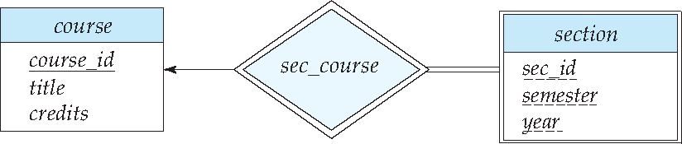
Expressing Weak Entity Sets
In E-R diagrams, a weak entity set is depicted via a double rectangle.
We underline the discriminator of a weak entity set with a dashed line.
The relationship set connecting the weak entity set to the identifying strong entity set is depicted by a double diamond.
Primary key for section – (course_id, sec_id, semester, year)

Slide 72
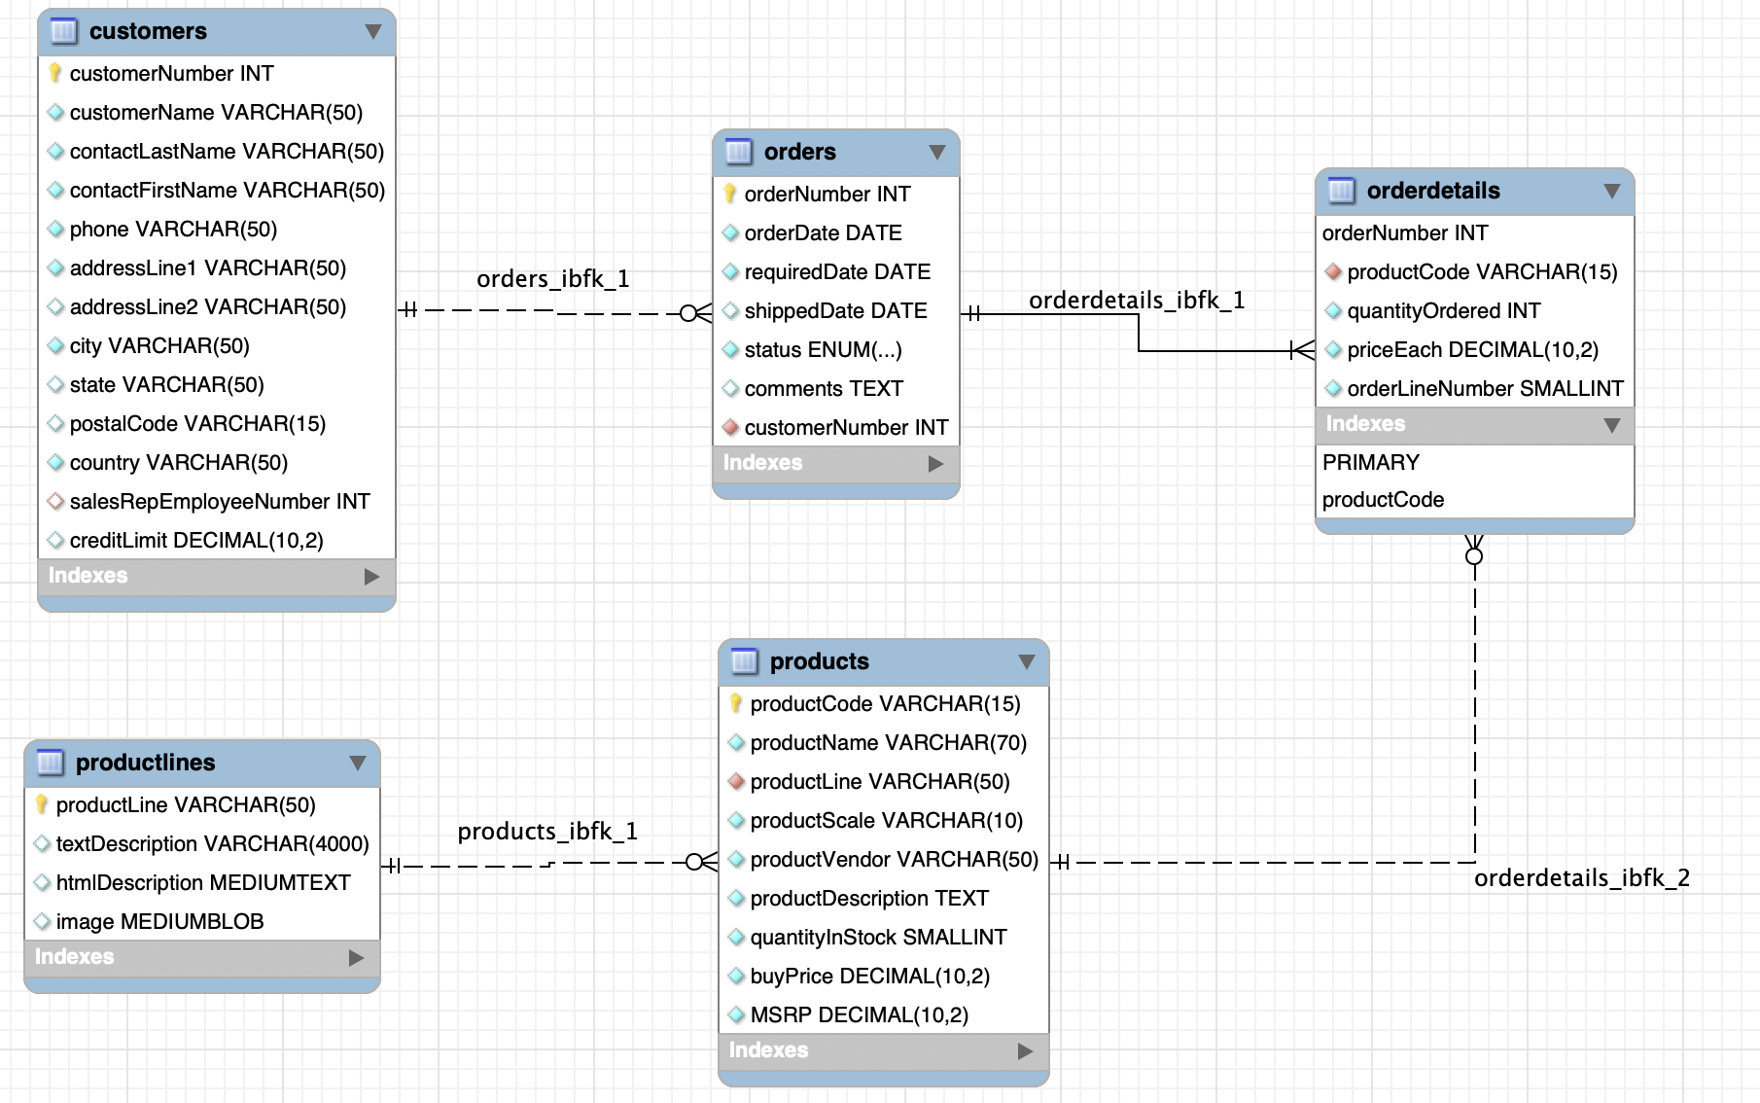
An Example – Classic Models
https://www.mysqltutorial.org/mysql-sample-database.aspx/
72 | Introduction to Databases (S22): Lecture 6: ER, Relational, SQL (V)

Slide 73
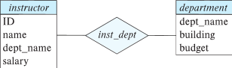
Redundant Attributes
Suppose we have entity sets:
instructor, with attributes: ID, name, dept_name, salary
department, with attributes: dept_name, building, budget
We model the fact that each instructor has an associated department using a relationship set inst_dept
The attribute dept_name in instructor replicates information present in the relationship and is therefore redundant
and needs to be removed.
BUT: when converting back to tables, in some cases the attribute gets reintroduced, as we will see later.

Slide 74
Design Alternatives
In designing a database schema, we must ensure that we avoid two major pitfalls:
Redundancy: a bad design may result in repeat information.
Redundant representation of information may lead to data inconsistency among the various copies of information
Incompleteness: a bad design may make certain aspects of the enterprise difficult or impossible to model.
Avoiding bad designs is not enough. There may be a large number of good designs from which we must choose.
Emphasis Added
Notes:
74

Slide 75
Aggregation
Consider the ternary relationship proj_guide, which we saw earlier
Suppose we want to record evaluations of a student by a guide on a project

Slide 76
Aggregation (Cont.)
Relationship sets eval_for and proj_guide represent overlapping information
Every eval_for relationship corresponds to a proj_guide relationship
However, some proj_guide relationships may not correspond to any eval_for relationships
So we can’t discard the proj_guide relationship
Eliminate this redundancy via aggregation
Treat relationship as an abstract entity
Allows relationships between relationships
Abstraction of relationship into new entity

Slide 77
Aggregation (Cont.)
Eliminate this redundancy via aggregation without introducing redundancy, the following diagram represents:
A student is guided by a particular instructor on a particular project
A student, instructor, project combination may have an associated evaluation
Notes:
77

Slide 78
Reduction to Relational Schemas
To represent aggregation, create a schema containing
Primary key of the aggregated relationship,
The primary key of the associated entity set
Any descriptive attributes
In our example:
The schema eval_for is:
eval_for (s_ID, project_id, i_ID, evaluation_id)
The schema proj_guide is redundant.

Slide 79
Specialization
Top-down design process; we designate sub-groupings within an entity set that are distinctive from other entities in the set.
These sub-groupings become lower-level entity sets that have attributes or participate in relationships that do not apply to the higher-level entity set.
Depicted by a triangle component labeled ISA (e.g., instructor “is a” person).
Attribute inheritance – a lower-level entity set inherits all the attributes and relationship participation of the higher-level entity set to which it is linked.

Slide 80
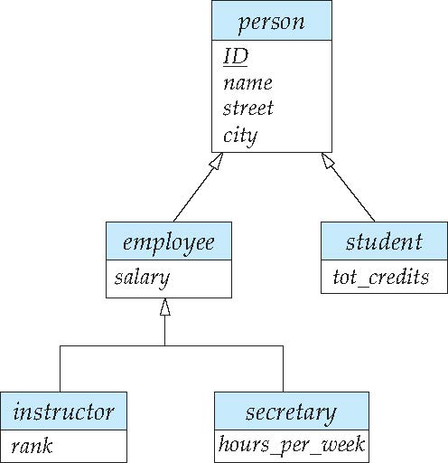
Specialization Example
Overlapping – employee and student
Disjoint – instructor and secretary
Total and partial

Slide 81
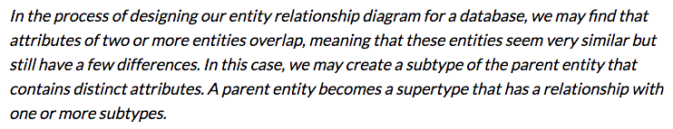
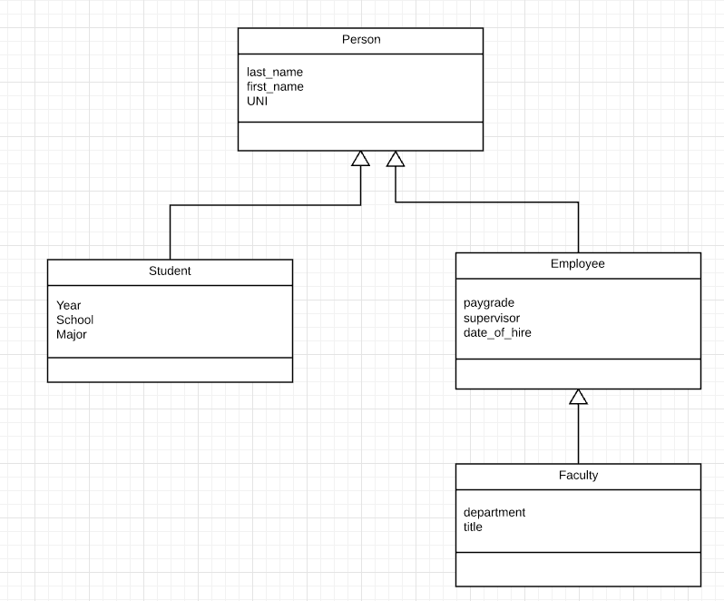
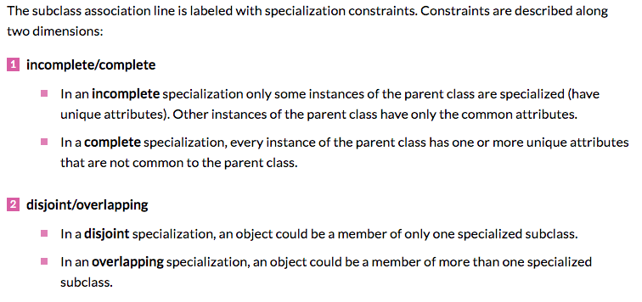
Inheritance, IsA, Specialization
Are all employees faculty?
Can students also be employees?
http://www.vertabelo.com/blog/technical-articles/inheritance-in-a-relational-database
81 | W4111_02_F20: Introduction to Databases – Lecture 6

Slide 82
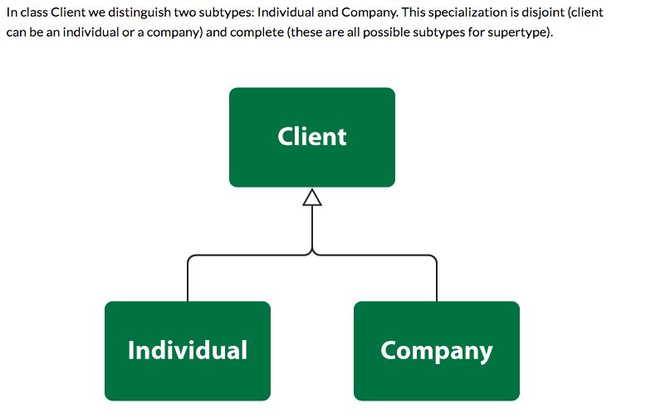
Simpler Example
82 | W4111_02_F20: Introduction to Databases – Lecture 6

Slide 83
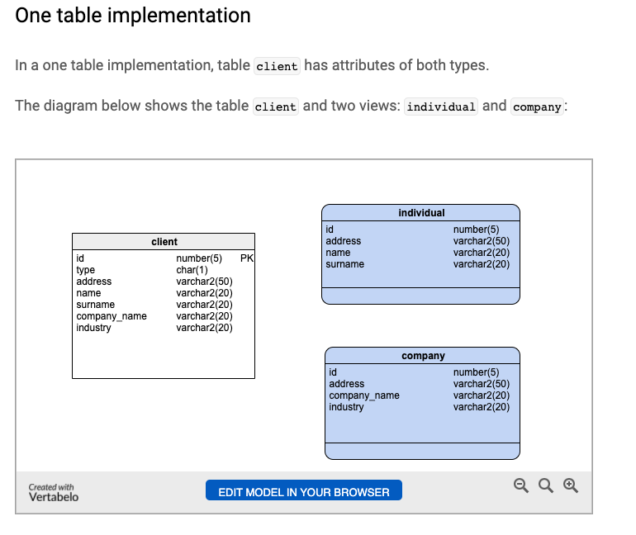
One Table Implementation
Views
Tables

Slide 84
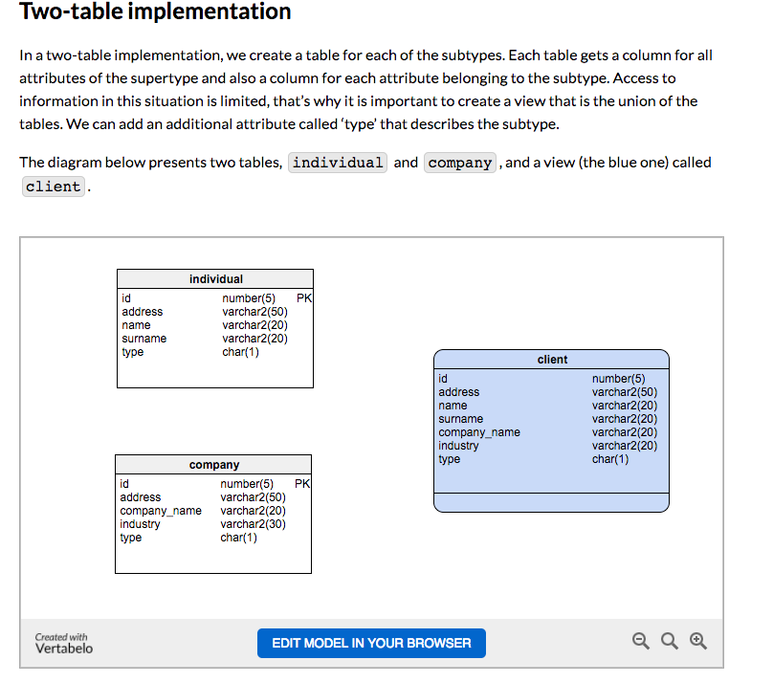
Two Table Implementation
View
Tables
84 | W4111_02_F20: Introduction to Databases – Lecture 6

Slide 85
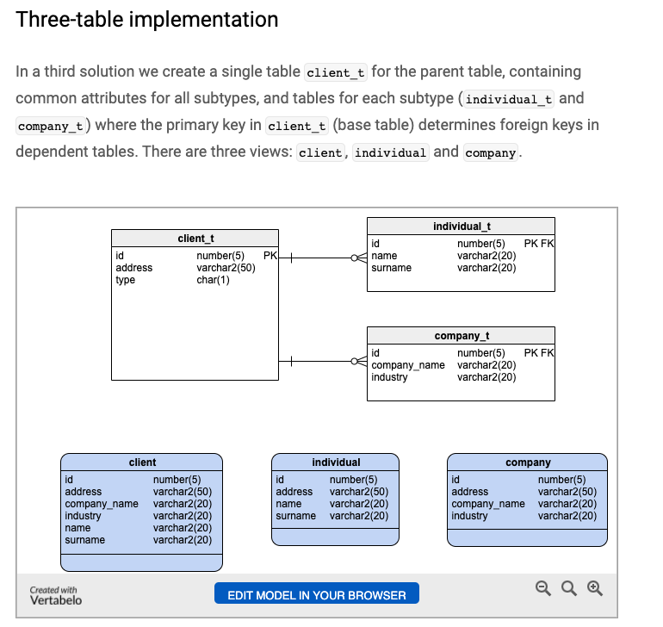
Two Table Implementation
Tables
Views
85 | W4111_02_F20: Introduction to Databases – Lecture 6

Slide 86
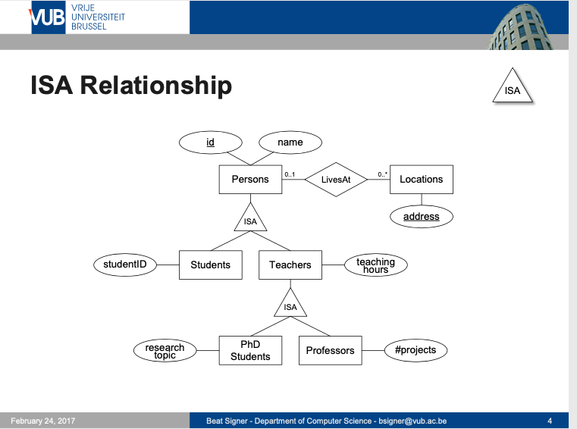
Modeling
86 | W4111_02_F20: Introduction to Databases – Lecture 6

Slide 87
ER vs. UML Class Diagrams
ER Diagram Notation
Equivalent in UML
I use this approach in Crow’s Foot Notation but that is not standard.
* Generalization can use merged or separate arrows independent
of disjoint/overlapping

Slide 88
Faculty, Student Inheritance Example
88 | Introduction to Databases (S22): Lecture 6: ER, Relational, SQL (V) © Donald F. Ferguson, 2022

